Slide 1
Working with Lingvo

Slide 2
How to execute?
Bazel or Python
Example execution on Python:
python3 -m lingvo.trainer --run_locally=cpu --mode=sync --model=mnist.LeNet5 --logdir=/tmp/mnist/log

Slide 3
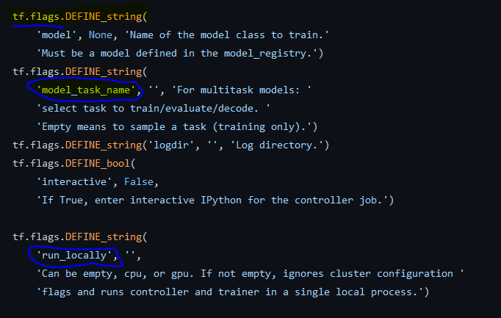
The trainer file
Found in the initial directory of Lingvo
Handles the high-level execution
Flags are present here

Slide 4
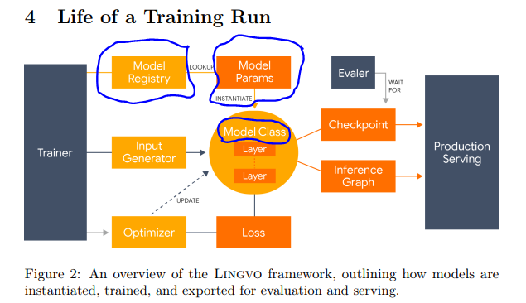
Life cycle of training

Slide 5
How to register models?
Basic explanation is provided in the Lingvo paper (See section 3.5)
Examples are provided in the tasks folder
Three main files are present when creating the model.
The model registration file (inherits from the classifier).
Base classifier file
Input generator

Slide 6
Model registration
3 functions are implemented:
Task, Train, and Test
All the model parameters/hyperparameters are defined here.
After parameter definition, the final creation happens once __init__ function is called.

Slide 7
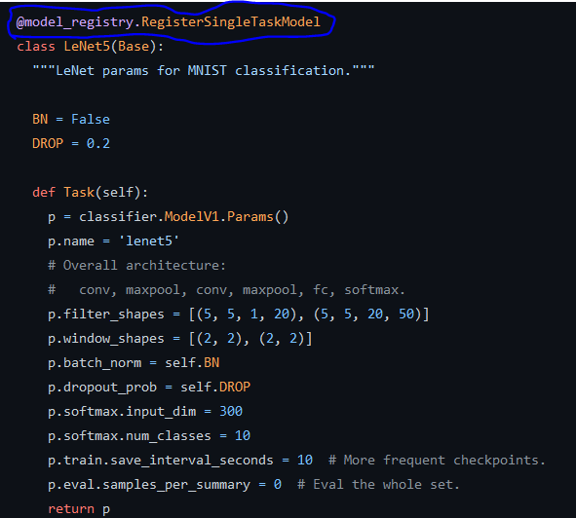

Slide 8
Layer creation in Lingvo
A layer can be composed of child layers. (refer Lingvo 2.2)
In the non-gpipe scenario, children are created at the uppermost level itself. (See classifier.py (__init__ function)

Slide 9
Non gpipe scenario
Task
layer1
Child layers
layer2
layer3

Slide 10
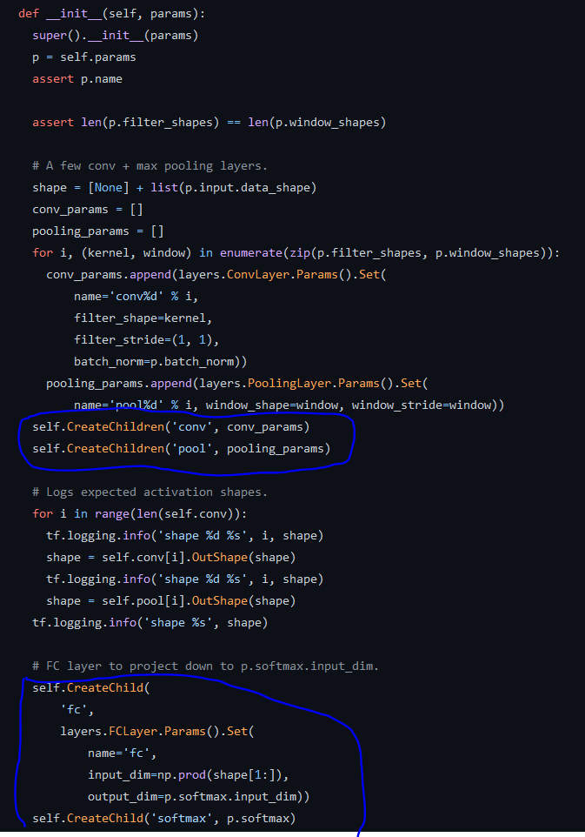

Slide 11
Gpipe scenario
Task
Pipelining layer
layer1
layer2
layer3

Slide 12
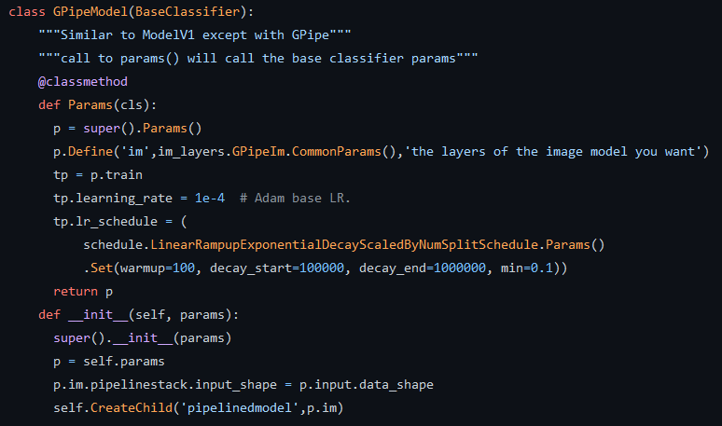
Only one child ‘pipelinedmodel’ at Task level

Slide 13
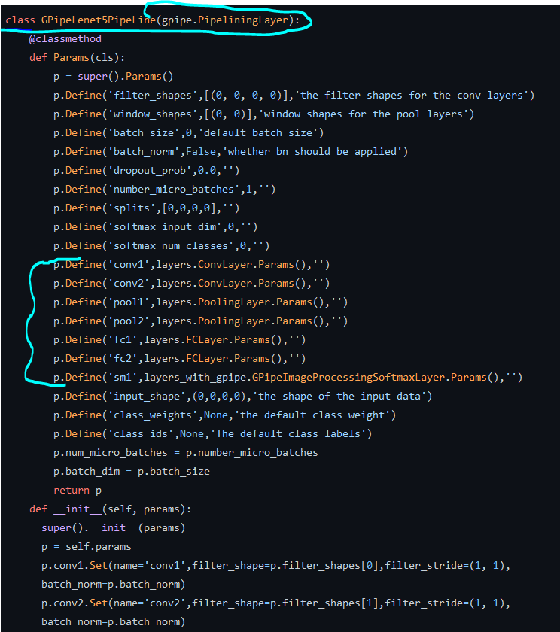

Slide 14
Modifications to GPipe
Gpipe auto-partitions a model based on Fprop costs.
Uses a function called Fpropmeta()
This has not been implemented for all layers, so had to be added.
Manual partitioning is also possible (which is what has been done)
For example see (gpipe_test.py) in core folder of Lingvo

